Slide 1
Management Information Systems
Prasad Padalkar
Module 4: Social Computing, Ebusiness and ECommerce

Slide 2
Topics
E-business and E-commerce
B2B
B2C.
Mobile commerce

Slide 3
What is E-Business ? What is E-Commerce?
E-business is a broader term that includes all business activities conducted online.
E-commerce is a specific subset of e-business that focuses on the buying and selling of goods and services.
For E.g. An online retailer like Amazon engages in both e-business and e-commerce. They sell products online (e-commerce), but they also use the internet for marketing, customer service, and supply chain management (e-business).

Slide 4
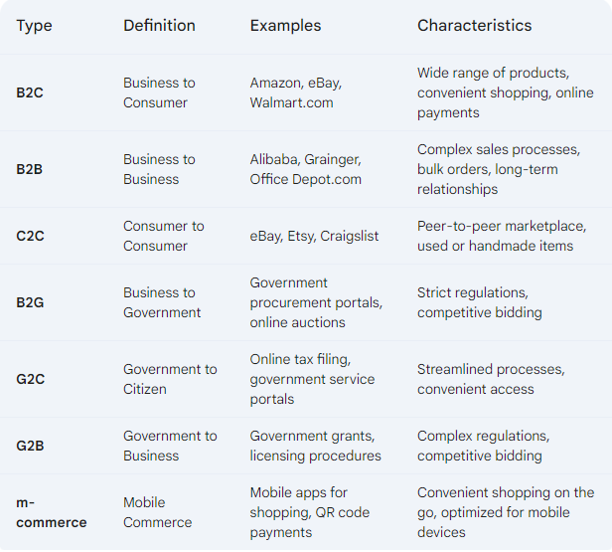
Types of E-Commerce

Slide 5
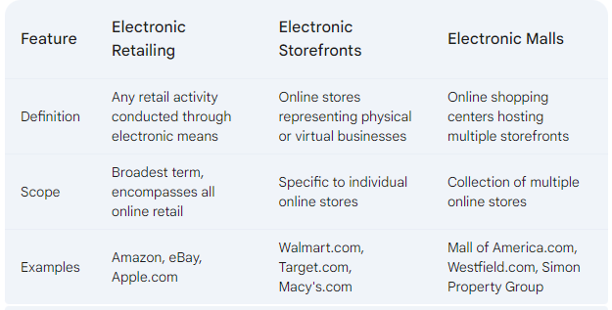
Terms in E-Commerce

Slide 6
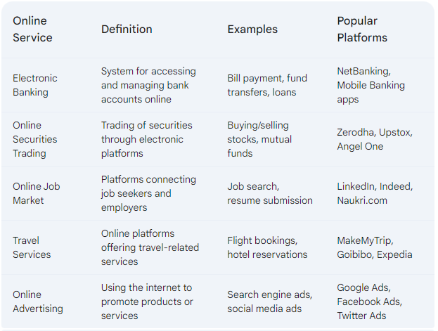
Online Services – B2C

Slide 7
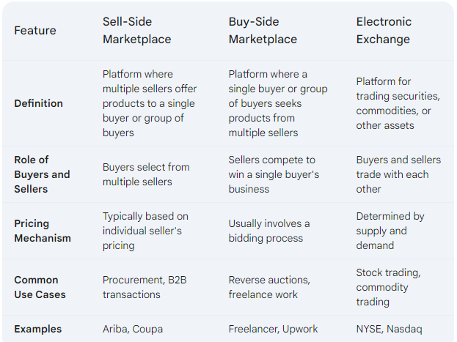
Online Services - B2B - Market places

Slide 8
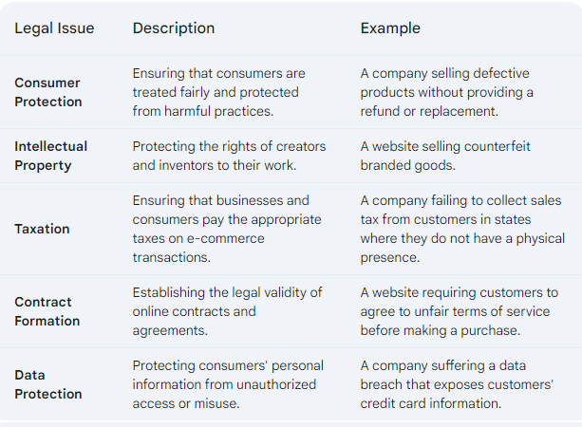
Legal Issues in E-Commerce

Slide 9
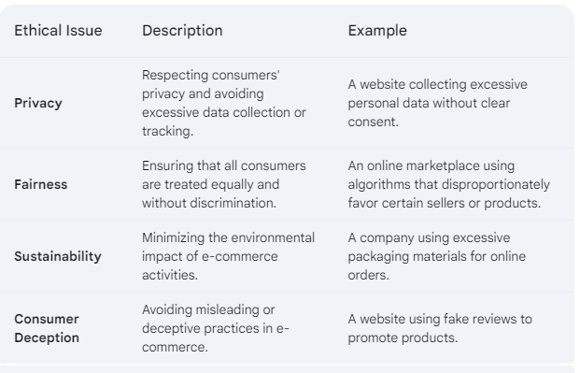
Ethical Issues in E-Commerce

Slide 10
Advantages of Mobile Computing
Portability: Mobile devices are small and lightweight, making them easy to carry around and use in various locations.
Accessibility: Mobile computing allows users to access information and services from virtually anywhere with an internet connection.
Efficiency: Mobile devices can be used to perform tasks quickly and efficiently, saving time and effort.
Personalization: Users can customize their mobile devices to suit their individual preferences and needs.
Cost-Effective: Mobile devices are often more affordable than traditional computers, making them accessible to a wider range of people.

Slide 11
What is M-Commerce
M-commerce (mobile commerce) is a type of electronic commerce that is conducted using mobile devices, such as smartphones and tablets.
It allows users to make purchases, access services, and conduct financial transactions using their mobile devices.

Slide 12
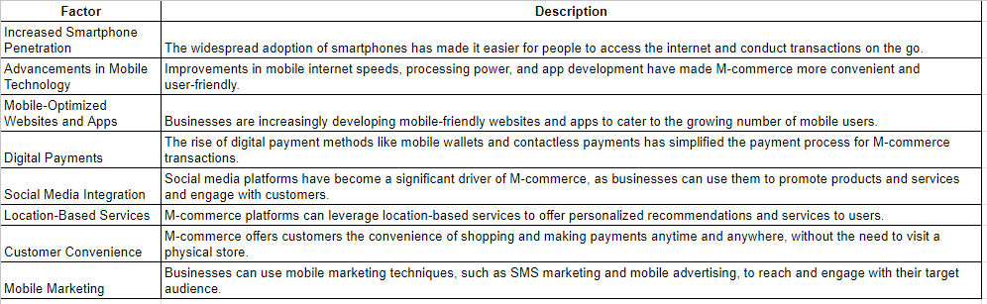
Driving Factors for M-Commerce

Slide 13
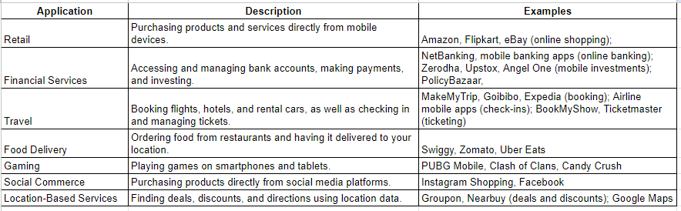
M-Commerce Applications

Slide 14


